Slide 1
Digital Circuits & Logic Design
Spring, 2025

Slide 2
Introduction
What is this course about?
Why we need to take this course?
Announcement

Slide 3
Digital Circuits
A green LED display turns on if all three gears are properly extended
A red LED display turns on if any of the gears fail to extend properly prior to landing

Slide 4
Logic Design

Slide 5
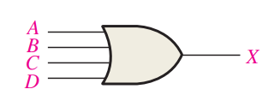
Boolean Algebra for Circuit Simplification

Slide 6
Course Outline
“Digital” concepts
Number systems and codes
Boolean algebra
Simplification of logic functions
Design and analysis of
Combinational logic
Sequential logic
Storage
ADC/DAC
Basics of Integrated Circuits

Slide 7
Introduction
What is this course about?
Why we need to take this course?
Announcement

Slide 8
Prerequisite for Computer Architecture
Systems (e.g., computers)
Functional Units
(e.g., Registers, Memories, Arithmetic units, etc.)
Gates and Flip-Flops
Circuits

Slide 9
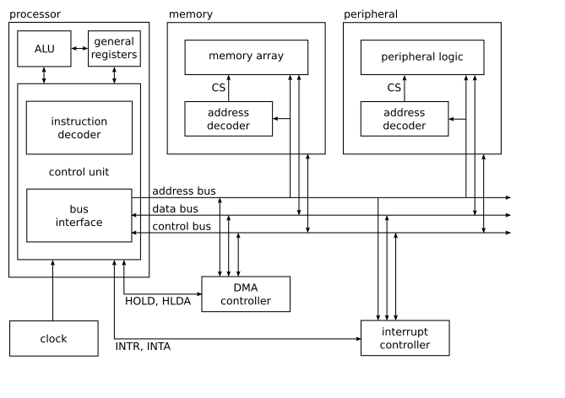
Basic Computer Architecture Example

Slide 10
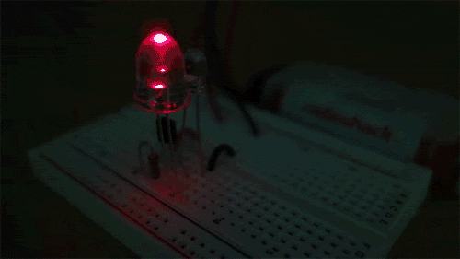
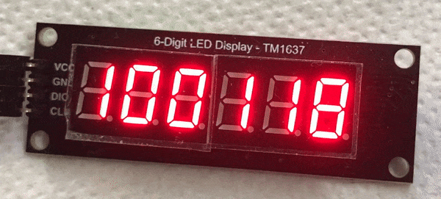
You can become an Inventor!

Slide 11
Explore Your Potential

Slide 12
Introduction
What is this course about?
Why we need to take this course?
Announcement

Slide 13
Digital Circuits
Instructor: Qianyi Huang (黄倩怡)
Affiliation: CSE of SYSU
Email: huangqy89@mail.sysu.edu.cn
Office: 529F, Guangzhou Supercomputing Center, East Campus

Slide 14
Teaching Assistant
Jilong Du (杜纪龙)
dujlong@mail2.sysu.edu.cn
Zilin Ye (叶子林)
yezlin5@mail2.sysu.edu.cn
They are responsible for homework grading, Q&A, etc

Slide 15
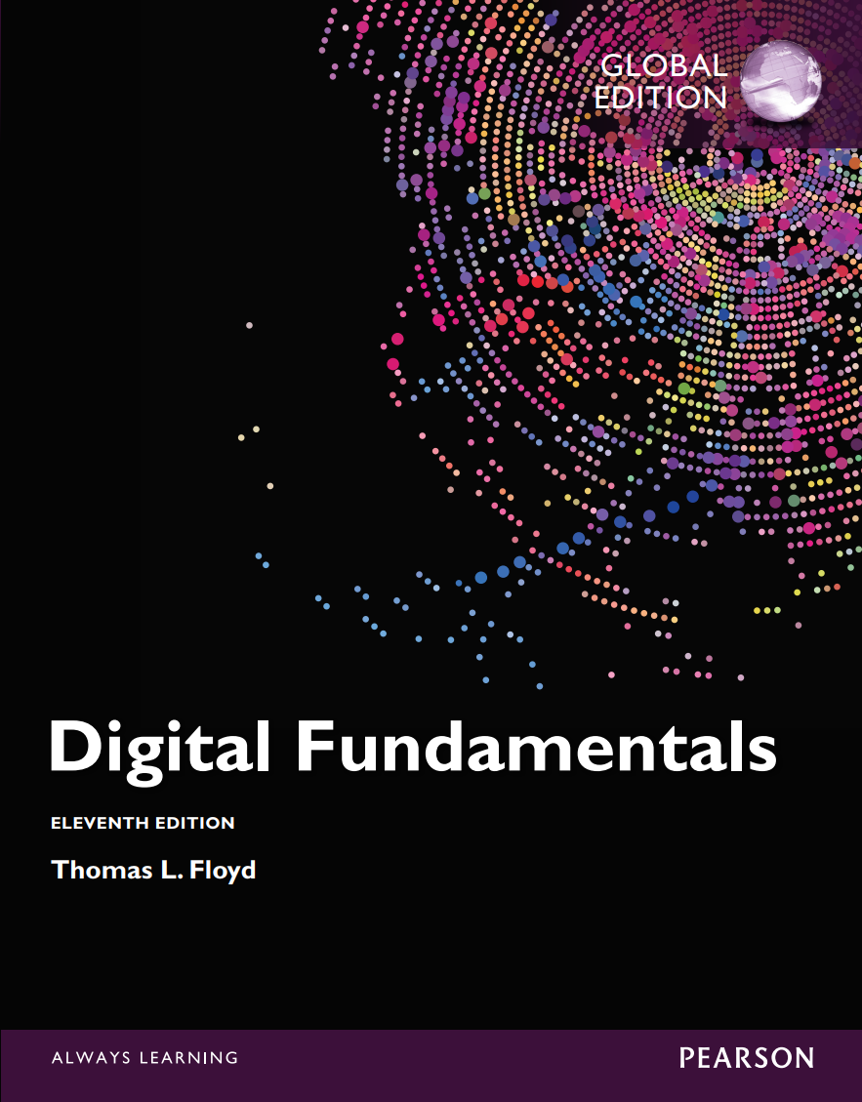
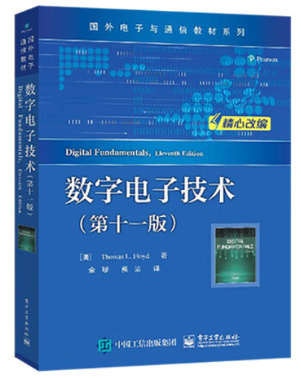
References
Book
T. L. Floyd, Digital Fundamentals, Eleventh Edition, Pearson
数字电路技术 (第十一版), 托马斯·弗洛伊德

Slide 16
Course Website
huangqy89.github.io/dc-2025
Lecture notes
Assignment
Laboratory
Textbook
Password: dc-2025

Slide 17
Schedule
Class Lecture:
Second Teaching Building: 2306 (Tuesday, 14:20 – 16:00, Week 1-17)
Second Teaching Building: 2306 (Thursday, 14:20 – 16:00, Week 1 to Week 9)
Quiz
Final Exam
Lab Section
Thursday, 19:00-21:35, Week 7-17
丰盛堂丰C503

Slide 18
Grading Policy
Regular grades 40%
Homework: 35%
Quiz : 5%
Absence: -1 per time
Answer questions correctly: +1 per time
Final Exam 60%

Slide 19
Suggestions
Understanding is everything!
Do the reading carefully!
Do all the homework carefully (No plagiarism)!
Make sure you’ve mastered the skills outlined at the end of each chapter
If you’re struggling, get help from the instructor & TAs

